Slide 1
SAP: Extend and Innovate
Presenter Name
Notes:
Information in this document, including URL and other Internet Web site references, is subject to change without notice. Unless otherwise noted, the example companies, organizations, products, domain names, e-mail addresses, logos, people, places, and events depicted herein are fictitious, and no association with any real company, organization, product, domain name, e-mail address, logo, person, place or event is intended or should be inferred. Complying with all applicable copyright laws is the responsibility of the user. Without limiting the rights under copyright, no part of this document may be reproduced, stored in or introduced into a retrieval system, or transmitted in any form or by any means (electronic, mechanical, photocopying, recording, or otherwise), or for any purpose, without the express written permission of Microsoft Corporation.
Microsoft may have patents, patent applications, trademarks, copyrights, or other intellectual property rights covering subject matter in this document. Except as expressly provided in any written license agreement from Microsoft, the furnishing of this document does not give you any license to these patents, trademarks, copyrights, or other intellectual property.
The names of manufacturers, products, or URLs are provided for informational purposes only and Microsoft makes no representations and warranties, either expressed, implied, or statutory, regarding these manufacturers or the use of the products with any Microsoft technologies. The inclusion of a manufacturer or product does not imply endorsement of Microsoft of the manufacturer or product. Links may be provided to third party sites. Such sites are not under the control of Microsoft and Microsoft is not responsible for the contents of any linked site or any link contained in a linked site, or any changes or updates to such sites. Microsoft is not responsible for webcasting or any other form of transmission received from any linked site. Microsoft is providing these links to you only as a convenience, and the inclusion of any link does not imply endorsement of Microsoft of the site or the products contained therein.
© 2017 Microsoft Corporation. All rights reserved.
Microsoft and the trademarks listed at https://www.microsoft.com/en-us/legal/intellectualproperty/Trademarks/Usage/General.aspx are trademarks of the Microsoft group of companies. All other trademarks are property of their respective owners.
June 2021

Slide 2
Abstract and learning objectives
In this workshop, you will learn how to architect a modern deployment of SAP on Azure. Throughout the whiteboard design session, you will explore a range of options that leverage Azure data and artificial intelligence services to enhance SAP-based solutions and maximize the benefits they bring in modern retail and manufacturing.
This workshop will help improve your ability to design and explain the integration of Azure services with SAP for collecting and transforming customers and inventory retail data. This, in turn, will contribute to more accurate trend predictions, optimized production targets, and increased revenues.

Slide 3
Step 1: Review the customer case study
Outcome
Analyze your customer needs.
Timeframe
15 minutes

Slide 4
Customer abstract
Contoso Retail, Inc has been facing challenges in modernizing its on-premises SAP landscape in order to better compete in the current marketplace. While Contoso already collects purchase data from all channels and updates daily warehouse logistical and operational data, this appears to be no longer sufficient.
The main challenges include:
Aging on-premises infrastructure, not capable of running more demanding analytical workloads.
Absence of a disaster recovery environment and limited high-availability provisions.
Expensive to maintain development and testing environments.
Insufficient visibility of supply and demand signals across the value chain, related primarily to delays in updates of inventories, customer sentiment, and trends driven through social media
Limited customer data, precluding the ability to implement targeted advertising.
Suboptimal delivery route planning and scheduling.

Slide 5
Customer abstract (continued)
As a struggling retailer, Contoso has been dealing with significant financial constraints. Given a hard limit of its capital expenditure budget, Contoso has been considering leveraging its operational budget and taking advantage of the pay-as-you-go model offered by Microsoft Azure.
To remedy its challenges, Contoso has asked you to design and implement a solution that would help them regain the competitive edge by transitioning their SAP landscape to Azure and modernizing it by leveraging Azure services.

Slide 6
Customer abstract (continued)
Key success criteria comprise:
A highly available SAP landscape
Minimized cost through right-sizing and optimized resource allocation
Data integration and analytics capabilities that include:
Comprehensive view of logistical and operational data, including sensor data from IoT devices in warehouses, stores, and manufacturing plants
Social media sentiment analytics and personalized marketing
Improved delivery route planning and scheduling, leveraging external data feeds that account for such factors as road closures or inclement weather
Optimized demand forecasting with automatic anomaly detection
Your primary objective is to provide integration across all data to be used for analysis and reporting, bringing together manufacturing, supply chain, and sales. Your solution should help the customer (represented by the Chief Marketing Officer, Chief Digital Officer, the Chief Data Officer, and the Customer Experience Manager) to deliver a 360 degree view of the Contoso's business operations and to optimize them through data analytics.

Slide 7
Customer situation
Contoso Retail, Inc has been producing and selling goods through various retail channels for the past 15 years. Currently, they have 20 manufacturing plants and just over 200 brick-and-mortar stores across the United States, but are planning to close 50+ of these stores next year, taking the number of physical locations down to 150 stores due to declining revenue and plans to focus on increasing the volume of online sales. Contoso relies on its on-premises SAP landscape to host line of business applications and databases for all manufacturing, supply chain, and customer data.
Contoso currently collects the store and online sales data and analyzes it within SAP, however, it recognizes that the scope and frequency of data collection and analysis is not sufficient to meet demands of the modern marketplace. To remediate this shortcoming, Contoso is looking for the ability to improve its existing model by not only providing more frequent inventory updates but also incorporating other sources of data, including:
Sensor data from IoT devices in warehouses, stores, and manufacturing plants
Social media sentiment analytics
External feeds with such information as road closures and inclement weather

Slide 8
Customer situation (continued)
Contoso wants to take control of their supply chain to ensure that their customers can easily locate and purchase the products they are interested in and that their stores are prepared to keep up with the actual demand. To accomplish this, Contoso will need to establish a 360 degree view of the supply chain, with data analysis and reporting that provides the business with the ability to address manufacturing and service issues, plan and schedule deliveries of products according to forecasted needs, and gauge these needs based on customer sentiment and up-to-date buying trends.

Slide 9
Customer situation (continued)
As part of its business plan, Contoso is looking to implement the following objectives:
Provision compute and storage resources which capacity exceeds what's currently supported by the aging on-premises infrastructure hosting the existing SAP landscape.
Increase resiliency by including full-fledged high-availability provisions and setting up a disaster recovery site.
Minimize cost of development and testing environments.
Whenever possible, simplify the operational model by leveraging managed services.
Enhance delivery route planning and scheduling by referencing external data feeds that account for such factors as road closures or inclement weather.
Integrate the SAP-resident data with disparate data sources, including Twitter feeds and IoT devices.
Automate collection, pre-processing, and analytics of streaming data.
Consolidate online and in-store data to facilitate targeted advertising tailored towards individual customers.
Improve online customer experience by leveraging AI technologies such as natural language understanding.

Slide 10
Customer Needs
Minimize the cost by right-sizing the SAP landscape implementation and optimize the use of compute resources.
Leverage Azure services to extend and innovate data collection and analysis (including sensor data from IoT devices, web site and app telemetry, as well as social networking feeds reflecting customer behavior, sentiment, and purchasing patterns).
Fine-tune inventory and staff management to ensure all channels are working with the optimal resource allocation according to predicted demands.
Streamline remediation of manufacturing service issues and enhance available-to-promise retail capabilities.
Minimize the operational overhead

Slide 11
Customer Objections
We currently have all the data we need, why do we need to do anything else?
We've spent a lot of money and time building out the systems we have, why should we start over in Azure rather than upgrade our existing hardware?
How will this solution help us to create a better process for getting our products from the manufacturing to the warehouses and then to the stores any quicker? Our staff is already working overtime and trucks won't be able to physically drive any faster while maintaining safety standards.
How can we ensure that privacy of our customers is sufficiently protected if we pursue targeted advertising by leveraging Azure services?

Slide 12
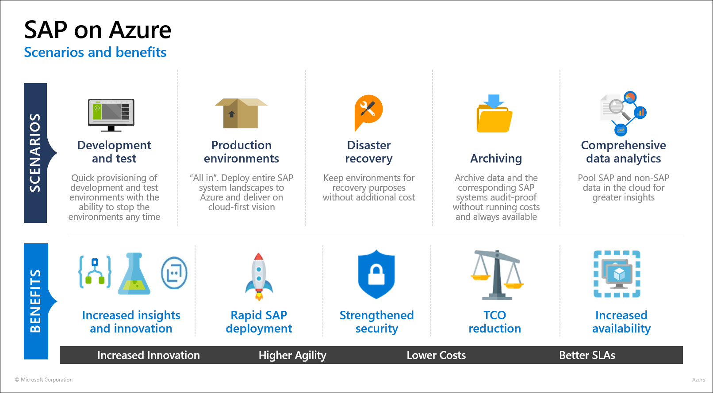
Common scenario

Slide 13
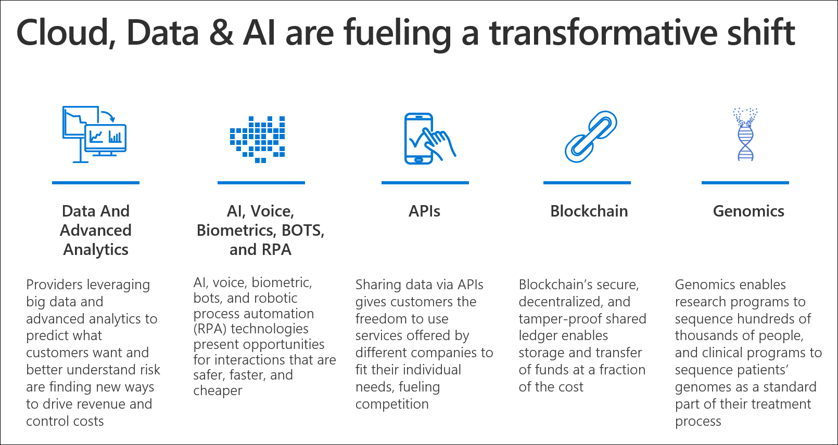
Common scenario

Slide 14
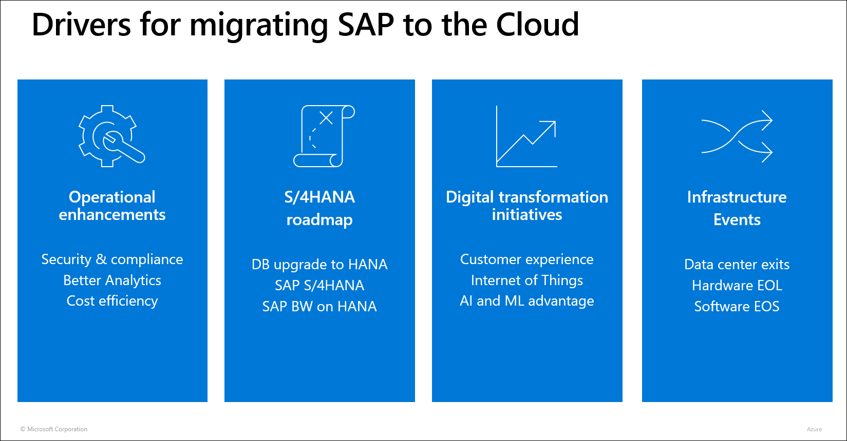
Common scenario

Slide 15
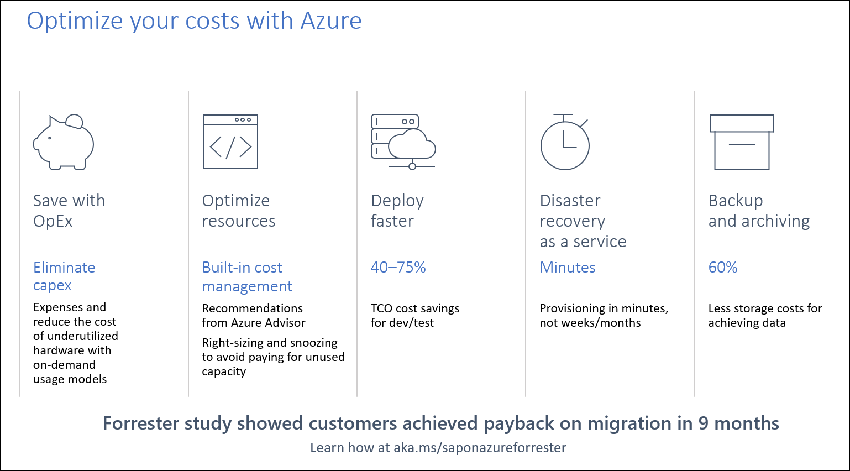
Common scenario

Slide 16
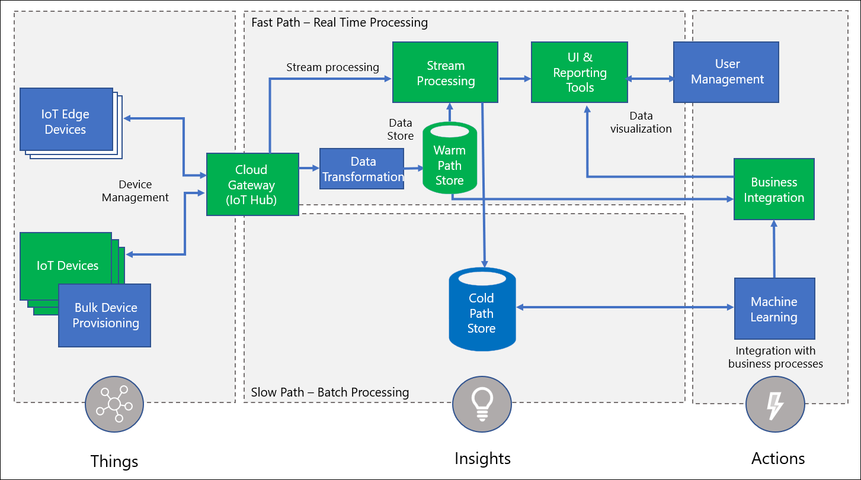
Common scenario

Slide 17









Common scenario
Microsoft Intelligent Edge
Azure IoT Edge
Azure Stream Analytics
Machine Learning
IoT Data and Context
Azure IoT Hub
SAP Business Context
SAP ESSENTIAL
BUSINESS FUNCTIONS
Business applications/systems
Microsoft Azure
Speed to Innovation
Speed to Value
Rapid co-innovation around unique solutions that span the intelligent enterprise
Integrated solutions across SAP Business Processes and Microsoft IoT Services

Slide 18
Step 2: Design the solution
Outcome
Design a solution and prepare to present the solution to the target customer audience in a 15-minute chalk-talk format.
Timeframe
60 minutes
Business needs (10 minutes) | Respond to questions outlined in your guide and list the answers on a digital Whiteboard.
Design (35 minutes) | Design a solution for as many of the stated requirements as time allows. Show the solution on a Whiteboard.
Prepare (15 minutes) | Identify any customer needs that are not addressed with the proposed solution. Identify the benefits of your solution. Determine how you will respond to the customer’s objections. Prepare for a 15-minute presentation to the customer.

Slide 19
Step 3: Present the solution
Outcome
Present a solution to the target customer in a 15-minute chalk-talk format.
Timeframe
30 minutes (15 minutes for each team to present and receive feedback)
Directions
Pair with another table.
One table is the Microsoft team and the other table is the customer.
The Microsoft team presents their proposed solution to the customer.
The customer asks one of the objections from the list of objections in the case study.
The Microsoft team responds to the objection.
The customer team gives feedback to the Microsoft team.

Slide 20
Wrap-up
Outcome
Identify the preferred solution for the case study.
Identify solutions designed by other teams.
Timeframe
15 minutes

Slide 21
SAP: Extend and Innovate
Whiteboard Design Session – Preferred Solution

Slide 22
High Level Architecture
The proposed solutions takes advantage of a wide range of Azure services in order to enhance the agility, resiliency, and resiliency of the customer's SAP landscape, as well as to deliver additional data integration capabilities. In particular, it provides the following functionality:
Support for in-region and cross-region redundancy, providing the high availability and disaster recovery capabilities.
A development and test environment, which cost can be minimized through an optimal resource sizing and snoozing.
Hot and cold paths for ingesting, processing, and storing data generated by IoT devices, implemented by using Azure IoT Intelligent Edge.
Hot and cold paths for ingesting, processing, and storing data generated by social media, implemented by a range of native Azure services.
Integration with Azure Machine Learning and Azure Cognitive Services.
Business integration that leverages Azure Logic Apps.

Slide 23
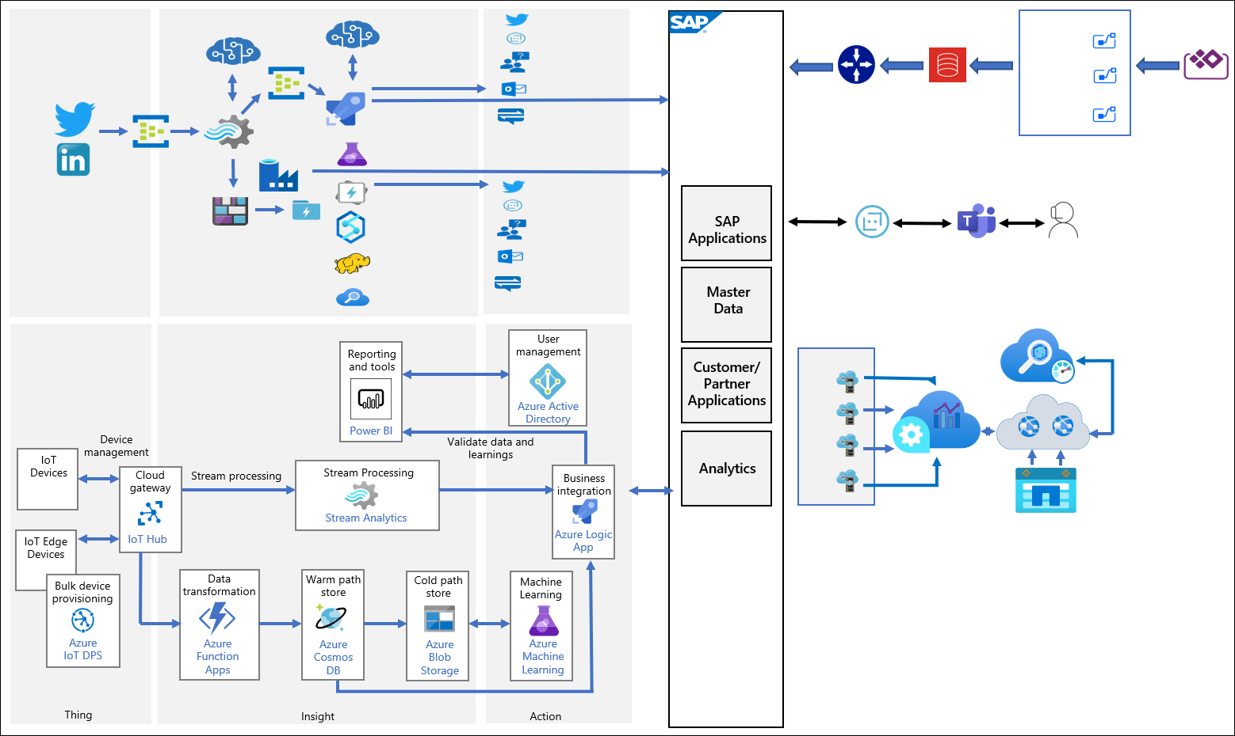
High Level Architecture Diagram

Slide 24
Ingestion and Integration (IoT)
Azure IoT Intelligent Edge a combination of Azure services and a runtime that runs on IoT devices. The runtime manages containerized modules that you can use to implement business logic in the form of SAP and in-house developed applications. The modules extend the application functionality to the edge of your enterprise, expediting a response to IoT device-generated events by applying relevant actions directly to the source. In addition, the modules handle bulk of processing tasks at the edge, limiting the dependency on the cloud compute and storage resources, lowering the corresponding cost. By running SAP Essential Business Functions modules on Azure IoT Edge, Contoso will be able to extend the reach of their S4/HANA and C4/HANA workloads directly to their assets, bringing the capabilities of business applications and governance to the edge.

Slide 25
Azure IoT Intelligent Edge Components
IoT Edge consists of the following components:
Azure IoT Hub, which provides a cloud-hosted backend to connect IoT devices with Azure cloud services. IoT Hub enables highly secure and reliable bi-directional communication, management, and provisioning (by using Device Provisioning Service, aka DPS) for IoT Edge devices.
Azure Storage provides flexible, scalable, secure, and inexpensive data store. The solution can use Azure Blob Storage or Azure Data Lake to store massive amounts of unstructured data.
Azure Cognitive Services are a family of AI services and cognitive APIs that help build intelligent apps. For example, the solution could provide image recognition by leveraging Computer Vision and Custom Vision services.
Machine Learning (ML) uses algorithms to automatically improve predictions or decisions through a self-learning process. Machine learning algorithms help ensure that the modules deployed to IoT devices remain accurate despite changing data trends.

Slide 26
Azure IoT Hub
Azure IoT Hub serves as an ingestion point for sensor-generated data. IoT Hub is a managed service that acts as a central message hub for bidirectional communications between IoT applications and IoT devices. It scales to millions of devices, reliably and securely connecting them to their backend solutions. With the IoT Hub's capabilities, you can build IoT solutions that manage equipment used in manufacturing and monitor retail inventory levels.

Slide 27
Ingestion and Integration (Logic Apps)
Azure Logic Apps simplify authoring and implementation of trigger-driven integration workflows that leverage a visual designer and 250+ connectors, including a bi-directional connector for SAP. The connector is compatible with on-premises and cloud-based HANA-based SAP systems, such as S/4 HANA, as well as with classic on-premises SAP systems, such as R/3 and ECC.
The SAP connector supports integration between non-SAP application and SAP systems through IDoc, BAPI, or RFC. For example, you can create a relatively simple Logic App that reads tweets, analyzes their text by employing Cognitive Services' Sentiment Analysis, and uses the SAP connector to store the outcome in a HANA DB. Logic Apps can also provide conditional workflow management, passing messages to downstream targets, such as a call handler, notification hub, or email, a tweet, or a chatbot.

Slide 28
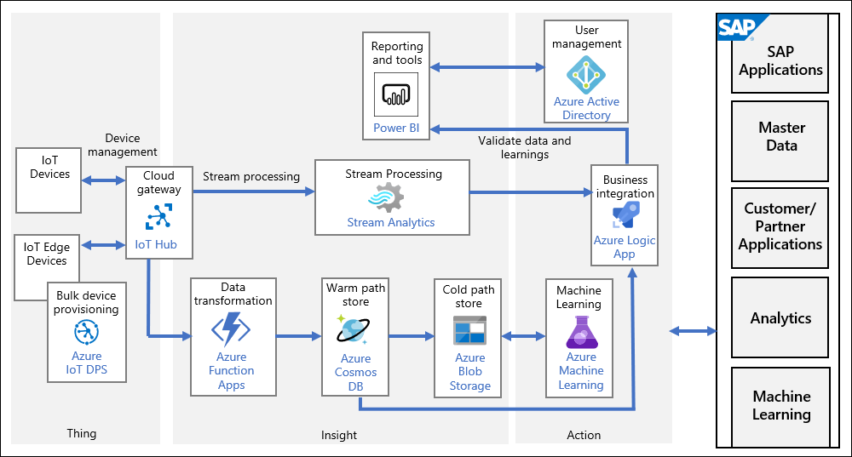
Ingestion and Integration Diagram (IoT)

Slide 29
Ingestion and Integration (Social Media)
In addition, business and customer data from sources such as social media postings, third party applications, and external sites can be ingested by using services such as Event Hub, parsed by Stream Analytics, aggregated into Azure Blob Storage or Azure Data Lake, and, subsequently, processed and analyzed by Azure Synapse Analytics, Azure HDInsight, or Azure Data Lake Analytics. At various points of the data path, you have the option to leverage Cognitive Services and Azure Machine Learning models to offer even deeper understanding of what customers might be interested in, based on such criteria as consumer sentiment or social media trending.
For integration purposes, you can take advantage of Azure Logic Apps or use Azure Data Factory as part of pipeline for social media feeds, transferring and manipulating data between Azure Blob Storage, Data Lake Store, or delivering it directly to SAP HANA. Azure Data Factory also allows you to extract data from SAP HANA and SAP Business Warehouse (BW) into Azure data stores, such as Azure Blob Storage and Azure Data Lake to facilitate implementation of advanced analytics with Azure Synapse Analytics.

Slide 30
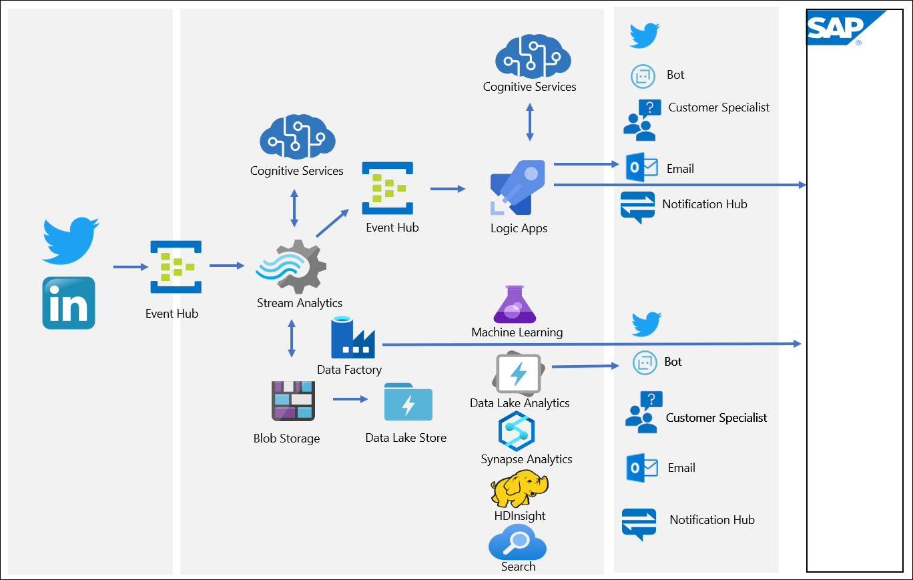
Ingestion and Integration Diagram (Social Media)

Slide 31
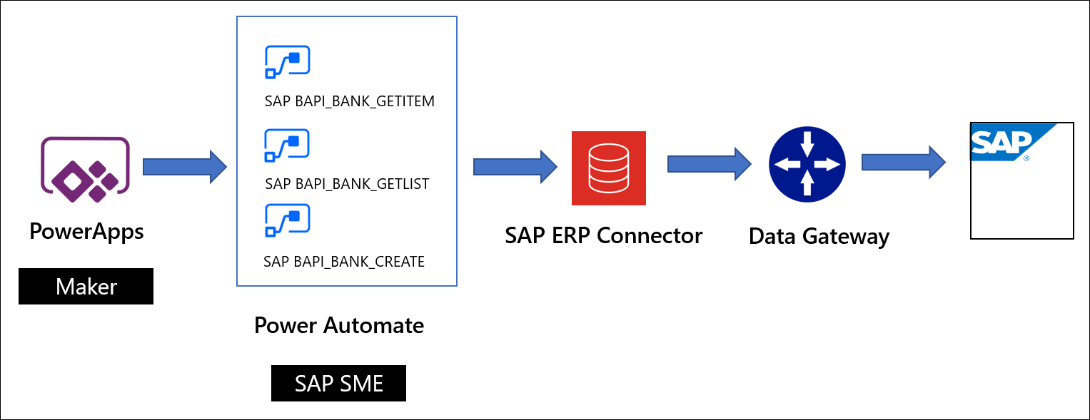
Ingestion and Integration (Power Platform)
Alternatively, it is possible to build low-code apps and workflows by using Microsoft Power Platform that includes SAP ERP connector for Power Apps and Power Automate, which provides the equivalent functionality. The connector is certified by SAP for integration with SAP S/4HANA and SAP ERP and allows integration with SAP ERP systems via BAPIs and RFCs, including support for dynamic schemas.

Slide 32
Transformation and Processing
You have the option of combining SAP and non-SAP data sources for additional transformation and processing. This might involve long-running batch jobs to filter, aggregate, and prepare data for further analysis. Processing options include U-SQL jobs in Azure Data Lake Analytics, Hive, Pig, and custom Map/Reduce jobs in an HDInsight cluster, or Java, Scala, and Python programs in a Synapse Analytics Spark cluster. It is also possible to use Azure Data Factory to extract data from SAP HANA and SAP Business Warehouse (BW) into Azure data stores, such as Azure Blob Storage and Azure Data Lake to facilitate implementation of advanced analytics with Azure Synapse Analytics.

Slide 33
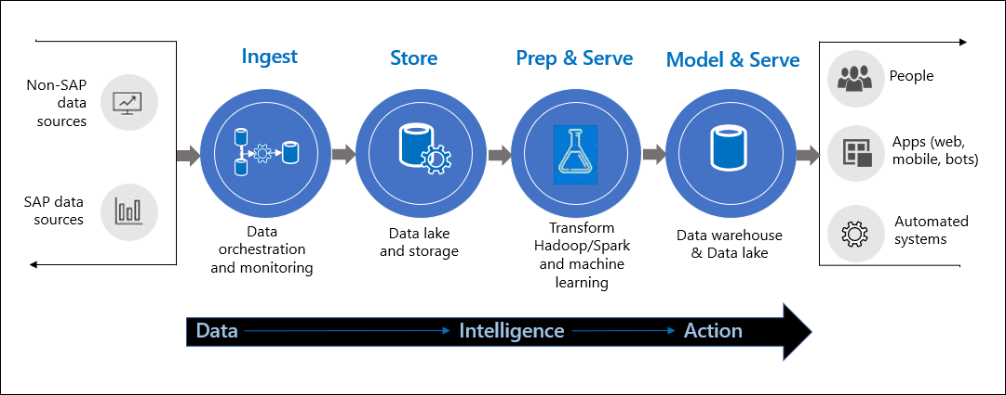
Transformation and Processing Diagram

Slide 34
Analytics
The solution prepares data for analysis and then serves the processed data in a structured format that can be queried using analytical tools. The analytical data store used to serve these queries can be a relational data warehouse, which is part of the existing business intelligence solution. Alternatively, the data could be presented through a low-latency NoSQL technology such as HBase, or an interactive Hive database that provides a metadata abstraction over data files in the distributed data store.
Azure Synapse Analytics provides a managed service for large-scale, cloud-based data warehousing. Synapse Analytics Spark tools are optimized for analyzing and transforming data for presentation. This analysis could reference data stored in Azure Cosmos DB. For example, Azure Synapse Link for Azure Cosmos DB enables you to run near real-time analytics over operational data in Cosmos DB.
To further enrich your data, you can combine data from your SAP databases with other systems pooled into Azure Data Lake. Synapse Analytics and Power BI dashboards facilitate monitoring supplier status, tracking inbound materials flows, and overseeing logistics in real time. This also helps to overlay operating status with external data such as road closures or inclement weather to identify potential problems before they impact production schedules or customer deliveries. By combining market and demand data with resource planning systems, you can further improve business forecasting.

Slide 35
Analytics (continued)
Another option that helps your further innovate the way you manage business data is Azure Anomaly Detector, which is part of Azure Cognitive Services. Anomaly Detector allows you to evaluate transactions, represented by time series data, across your entire SAP landscape in order to detect potential issues before they might have a negative impact. Based on incoming telemetry sources, the Anomaly Detector solution detects if there is a sudden change in creation or update processes. The detection algorithm can detect these issues automatically, in real time, and notify you in order to initiate a corrective action.
For example, Contoso could use Anomaly Detector to monitor changes to the Master Data Management (MDM) space, hosting objects representing business entities such as customers and business partners to detect and, optionally, remediate any unusual patterns. Similarly, Contoso could leverage Anomaly Detector to detect a sudden increase in online purchases of a particular product on its e‑commerce website. This would allow to take immediate actions to ensure product availability.

Slide 36
Anomaly Detector
Contoso could implement Anomaly Detector with native Azure services composing decoupled business logic and the presentation layers. These services include:
An Azure web app, which forms the presentation layer. Its purpose is to allow users to call the anomaly-detection service by using the prepared time-series data. The choice of Azure web app gives Contoso's developers the option to work in their preferred language, such as .NET, .Java, Ruby, Node.js, PHP, or Python. In addition, the app endpoint can be protected by leveraging Azure AD for authentication and authorization.
Two Azure function apps, which host all business-logic functionality. The first is used to connect to Azure Application Insights and capture SAP telemetry, such as customer or business-partner processes that are target of anomaly detection. This function app transforms target data into JavaScript Object Notation (JSON) format with time-series subformatting. The second function app captures the precompiled time-series data from the first function app, makes a call to the Anomaly Detector service, and then retrieves the result. At that point, the web app presentation layer displays the results in a graph format.
Application Insights, which stores all SAP log data. This log data is captured from various business processes, including Customer Master Data creation, Business Partner Creation and updates, and batch program logs. These logs serve as the source for anomaly detection.
Azure Anomaly Detector, which exposes API to detect and returns all anomaly points based on time-series data sent by the function app. It is possible to interact with Anomaly Detector either by using directly the HTTP REST API or by relying on client SDK.

Slide 37
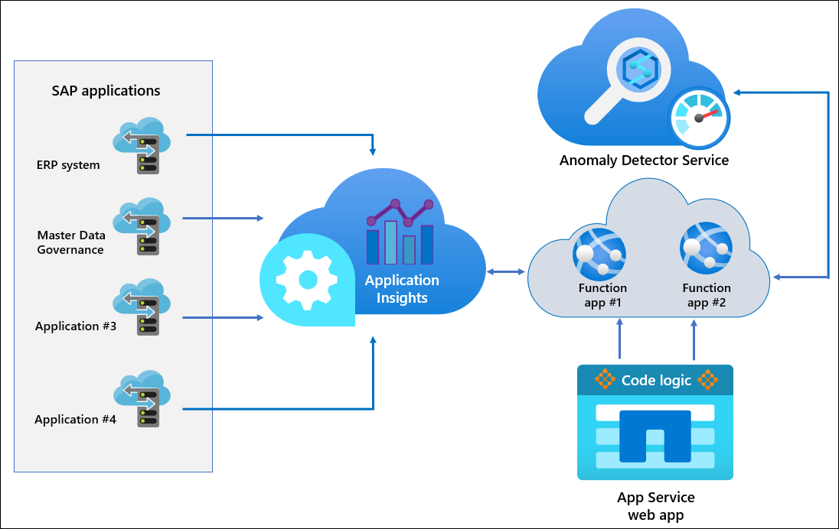
Anomaly Detector Diagram

Slide 38
Personalized Marketing
Personalized marketing focuses on targeting marketing initiatives and messaging to specific individuals that are either current or prospective customers. For this approach to be effective, Contoso needs to have access to customers' data and employ data analysis and artificial intelligence.
Furthermore, SAP applications can leverage Azure Cognitive Services for a number of purposes, including face recognition, text recognition, and natural language understanding. By deploying Cognitive Services, SAP will be able to analyze information closer to the physical world where the data resides and deliver real-time insights and immersive experiences that are highly responsive and contextually aware. For example, SAP Conversational AI can be implemented in combination with Azure bot channels to enhance conversational experience for online customers, including the ability to communicate via Microsoft Teams. Azure bot channels can be connected directly to Microsoft Teams. In this configuration, bots act as intermediaries between a Teams user and a web service that provides the AI functionality.
The integration with Microsoft Teams takes advantage of their support for conversational bots and can additionally leverage Azure Cognitive Services, including Language Understanding (LUIS) and QnA Maker. Contoso could use bots to run simple, repetitive automated tasks, such as answering common questions about its products, which traditionally were performed by their customer service or support staff.

Slide 39
Preferred Objections Handling #1
Objection:
We currently have all the data we need, why do we need to do anything else?
Potential answer:
The traditional approach to data integration is no longer sufficient in the modern marketplace. Retailers can now derive meaningful benefits from end-to-end visibility of supply and demand signals across the value chain. This starts at a store aisle, where smart sensors powered by Azure IoT Edge can detect movement of physical products on shelves and automatically trigger restocking processes. Real time inventory fluctuations can be processed by Azure Stream Analytics and fed into the SAP Forecasting and Replenishment (SAP F&R) solution to automate and accelerate the supply chain cycle. In parallel, retailers could leverage external data that represents external conditions in order to evaluate how they may affect local demand patterns. The ability to account for external data such as breaking news, weather, or sporting events can help detect and align to shifts in customer demand within hours. Predictive intelligence provided by Microsoft and SAP analytics tools, AI and machine learning models facilitates implementing such solutions, resulting in optimized procurement cycles, minimizing waste and maximizing profits.
Similarly, companies can use Azure analytics and Power BI dashboards to monitor supplier status, inbound materials flows and logistics in real time. Through Azure, they can overlay operating status with external data such as road closures or inclement weather to predict problems before they can impact production schedules or customer deliveries.

Slide 40
Preferred Objections Handling #1 (continued)
Potential answer:
By combining SAP- and Azure-based analytics, it becomes easier to uncover sales trend and customer preferences, resulting in optimized production targets and increased revenues. By expediting planning cycles in coordination with supplier networks and logistics providers, retailers can get products to market faster and deliver tailored products at scale.
In addition, retailers can leverage new sources of customer and market data such as social network postings or review sites from outside the organization. This provides even deeper understanding of customers buying patterns and helps track their changes in real time. Such data can be ingested, aggregated, and analyzed by leveraging Azure AI and ML models to predict what offers and experiences will have the most significant impact. At the same time, availability of such data helps build highly accurate and granular profiles for each customer to understand their unique interests and buying patterns. This, in turn, makes it more likely to be able to effectively capture customers' attention, improving their satisfaction and the likelihood of making an actual purchase.

Slide 41
Preferred Objections Handling #1 (continued)
Potential answer:
Similarly, in the manufacturing scenarios, companies like Contoso will benefit from transitioning to the connected factory paradigm. Modern systems that carry out manufacturing tasks are equipped with smart sensors and controls that directly integrate them with the Internet-connected world. These connected assets can communicate their status as well as receive and process digital input, offering new ways to monitor and automate production lines. Device signals can report equipment health and maintenance needs or help identify efficiency problems either at the individual machine level or in the interactions between machines over an end-to-end production workflow. By incorporating this operational data with existing IT systems and line-of-business applications, manufacturers gain an integrated view of the production landscape and fine-grained control over the physical processes that determine factory performance.
Sensor-equipped smart machines considerably simplify predictive maintenance and servicing, which minimize operational failures and the corresponding lost productivity. They also provide manufacturers with the ability to track real-time status of their environment, which helps detect anomalous behavior patterns. Tools such as Microsoft Power BI help create operator dashboards that automatically refresh at scheduled intervals, delivering an easy-to-analyze overview of up-to-date utilization and efficiency levels.
Combining business data with device telemetry and operational data can significantly increase production efficiency and flexibility, providing an integrated view of operations and improving control over physical production processes. Azure AI and ML solutions help build autonomous workflows that reduce human intervention while improving quality and performance.

Slide 42
Preferred Objections Handling #2
Objection:
We've spent a lot of money and time building out the systems we have, why should we start over in Azure rather than upgrade our existing hardware?
Potential answer:
While it is possible to leverage Azure services in hybrid scenarios with your on-premises SAP landscape, by migrating it to Azure you will be able to fully realize the benefits that the cloud environment has to offer. These benefits go beyond increased agility, resiliency, and scalability, resulting also in meaningful cost savings. A Forrester study published in 2019 found that organizations which migrate SAP to Azure can expect more than a 100% return on investment within 3 years. According to the same study, by the second year, organizations will typically be able to reduce staff required to manage SAP infrastructure by 50% and accelerate SAP releases by 100% due to the ability to rapidly provision test environments. Effectively,
organizations can accelerate development cycles, run test marketing campaigns and validate new product opportunities much faster, greatly reducing time to market. Similarly, financial and human resources previously dedicated to IT overhead can be allocated to pursuing product and business innovation and new market growth initiatives.

Slide 43
Preferred Objections Handling #2 (continued)
Potential answer:
Azure is SAP certified to run your mission-critical SAP applications. It offers is the industry's most performant and scalable SAP cloud infrastructure, including 25+ configurations that span virtual machines and purpose-built bare metal instances with memory ranging from 192GB to 24TB, in more regions than any other public cloud provider. You also benefit from Azure security services and the industry's largest compliance portfolio for workloads in the cloud and on-premises.
In addition, Azure facilitate innovation, with a wide range of services that support different data ingestion, integration, transformation, processing and visualization services. Your new solution will not only leverage the data that is currently in place, but, you will be able to further enrich it by taking advantage of such functionality as cloud-native machine learning and artificial intelligence, including virtual and augmented reality, image recognition, and natural language processing.

Slide 44
Preferred Objections Handling #3
Objection:
How will this solution help us to create a better process for getting our products from the manufacturing to the warehouses and then to the stores any quicker? Our staff is already working overtime and trucks won't be able to physically drive any faster while maintaining safety standards.
Potential answer:
The solution will help Contoso with optimizing this process. The objective is to improve efficiency rather than increasing speed or the amount of effort. This means having trucks that are fully loaded with the correct products and warehouses that are staffed with the staff best equipped to handle the task at hand. To accomplish this, you will take advantage of predictive analytics that take into account historical data and combine it with Azure AI and ML services to derive the most likely future outcome. You will also benefit from the availability of external data, such as road closures or inclement weather to identify potential problems before they might impact production schedules or customer deliveries.

Slide 45
Preferred Objections Handling #4
Objection:
How can we ensure that privacy of our customers is sufficiently protected if we pursue targeted advertising by leveraging Azure services?
Potential answer:
Microsoft fully understands that its customers need to comply with their national, regional, and industry-specific requirements and offers full transparency regarding provisions it offers in this area. These provisions include strict standards regarding the privacy and protection of customer data. For more information regarding this topic, refer to https://azure.microsoft.com/en-us/support/legal/cognitive-services-compliance-and-privacy/

Slide 46
Customer Quote
"We are truly satisfied with the results offered through the provided solution. By migrating our SAP landscape to Azure, we have not only increased its agility and resiliency, but also realized meaningful cost savings and, through integration with Azure services, gained an extra competitive advantage. Now we are able to reliably base our tactical and strategic planning on end-to-end business data that incorporates interconnected operations and leverages cutting-edge technologies like AI, machine learning, and IoT. We also got to know better our customers and improved their satisfaction by taking advantage of social networking and Azure Cognitive Services."
- Guy Information, CIO, Parts Unlimited Retail

